Slide 1
Burned Area Segmentation using Nautilus
MORENet Technical Summit
20 Feb 2023

Slide 2
Outlines
What is the problem
What is the data
What is the tool
Preparing workspace
Generating yml files
Training cycle sample
Results sample
Statistics about using Nautilus

Slide 3
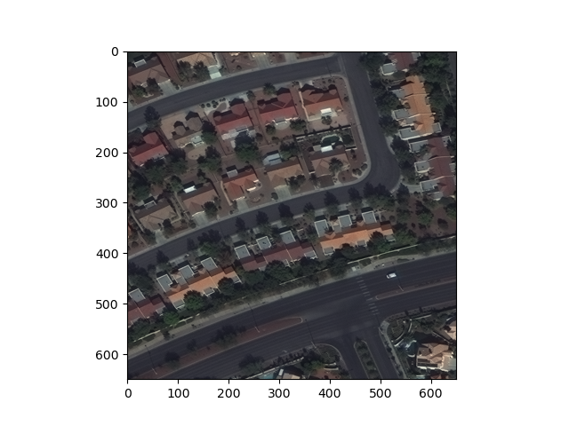
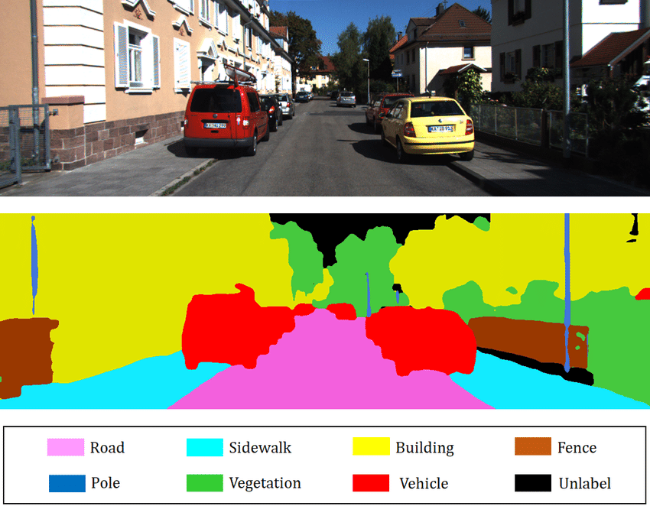
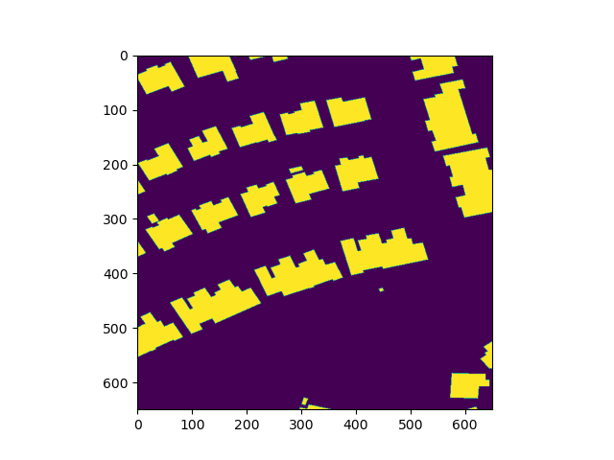
What is the problem
Semantic Segmentation:
The precise classification of every pixel in the image into one of the classes

Slide 4
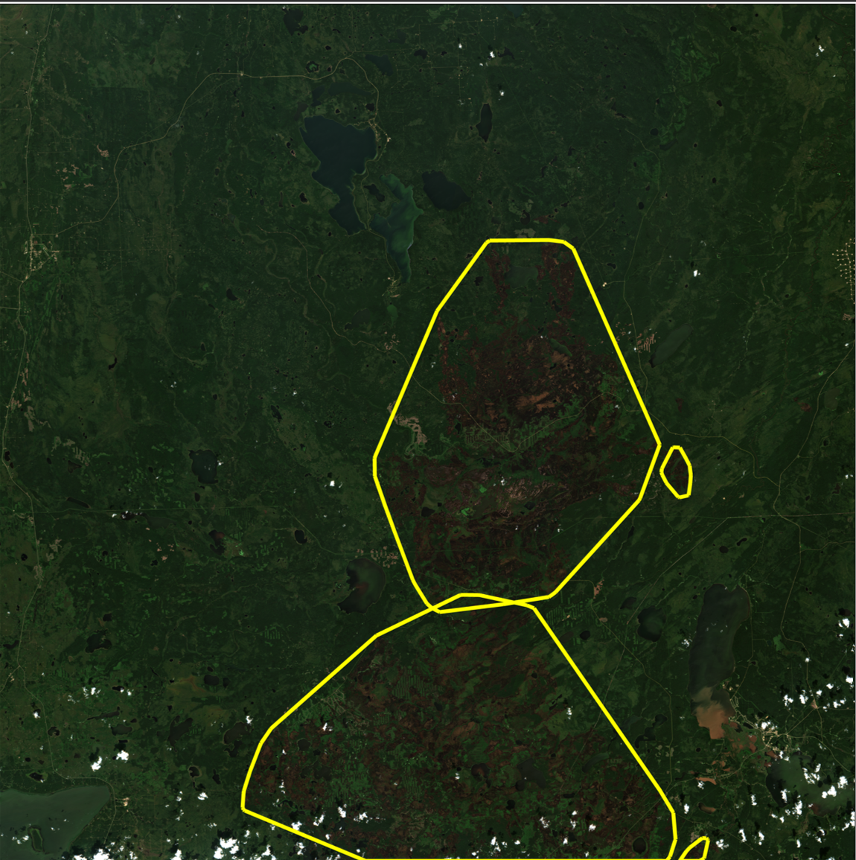
What is the data
Hyperspectral satellite imagery
Geotagged
It has a coordinate reference system
Each pixel is also a coordinate on the earth
It has multiple bands
Visible range (R,G,B)
NIR
SWIR

Slide 5
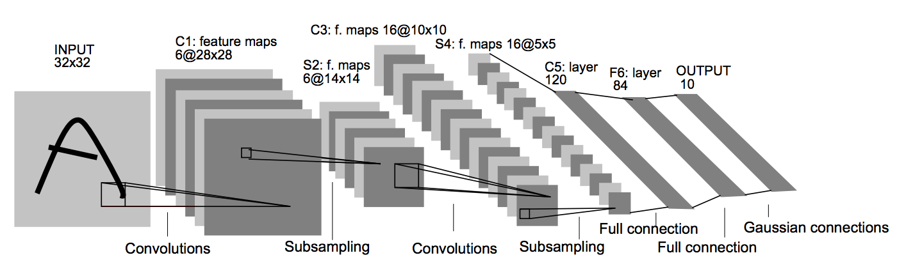
What is the tool
Convolutional Neural Network (CNN)
image classification
Target detection
Semantic segmentation

Slide 6

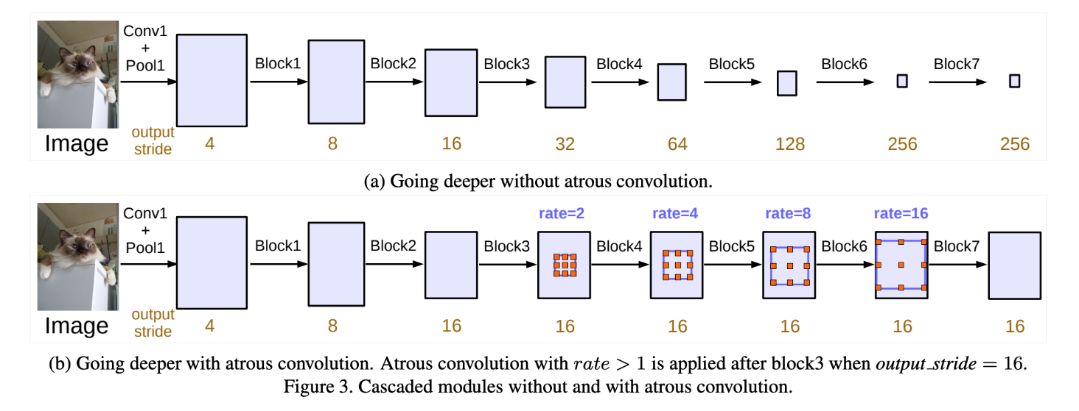
What is the tool
U-Net
Deeplab

Slide 7
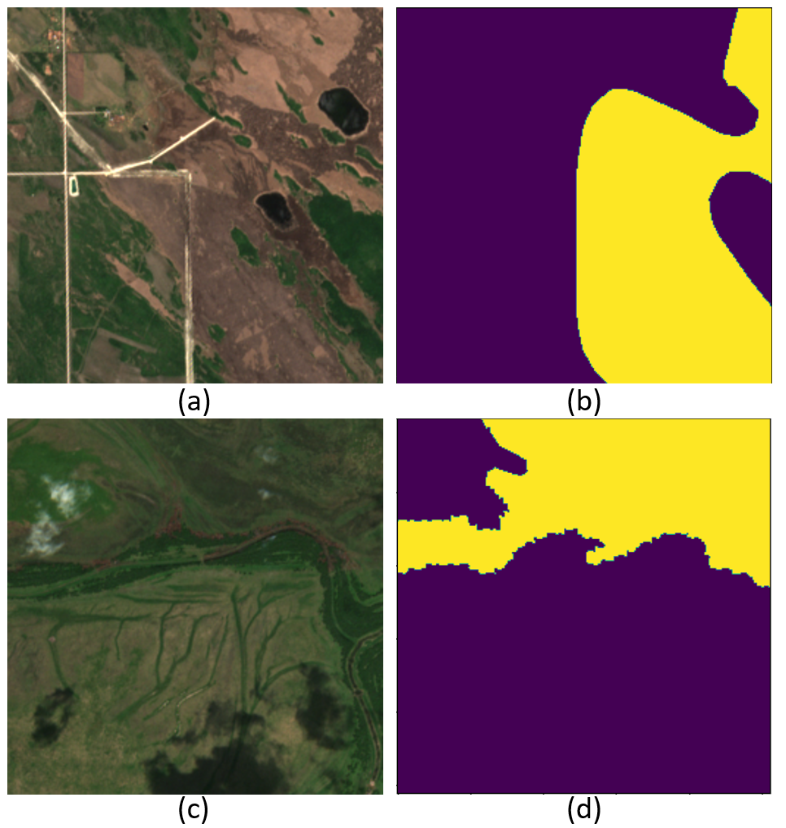
Preparing workspace Dataset
Train
Images
Validate
Test
Dataset
Train
Labels
Validate
test

Slide 8
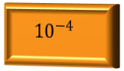
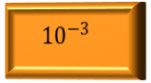
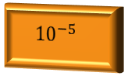
Preparing workspace config files
Config options
The config file allows us to specify options for each model
The architecture to be used
The learning rate
The batch size
The optimizer
Architecture
Learning rate
Batch size
Optimizer
Weight initialization
U-Net
$${10}^{−3}$$
8
Adam
Random
Deeplab
$${10}^{−4}$$
16
LAMB
ImageNet
$${10}^{−5}$$
32

Slide 9
Preparing workspace config files
{
"epochs": 100,
"model_architecture": "Unet",
"model_args": {
"encoder_name": "resnet50",
"encoder_weights": "imagenet"
},
"gpus": [0],
"batch_size_per_gpu": 4,
"num_classes": 2,
"training_data": [{
"image_dir": "/canada2019-3/training_data_png/tcis/train",
"mask_dir": "/canada2019-3/training_data_png/labs/train"
}],
"optimizer_name": "Adam",
"optimizer_args": {
"lr": 0.001
},
"validation_data": [{
"image_dir": "/canada2019-3/training_data_png/tcis/validate",
"mask_dir": "/canada2019-3/training_data_png/labs/validate"
}],
"validate_while_training": true
}

Slide 10
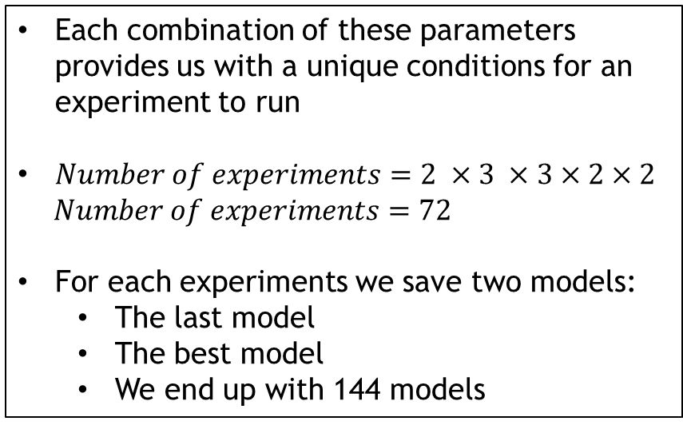
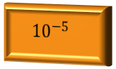
Preparing workspace yaml files
Config options
Each combination of these parameters provides us with a unique conditions for an experiment to run
$Number of experiments=2 ×3 ×3×2×2$
$Number of experiments=72$
For each experiments we save two models:
The last model
The best model
We end up with 144 models
Architecture
Learning rate
Batch size
Optimizer
Weight initialization
U-Net
$${10}^{−3}$$
8
Adam
Random
Deeplab
$${10}^{−4}$$
16
LAMB
ImageNet
$${10}^{−5}$$
32

Slide 11
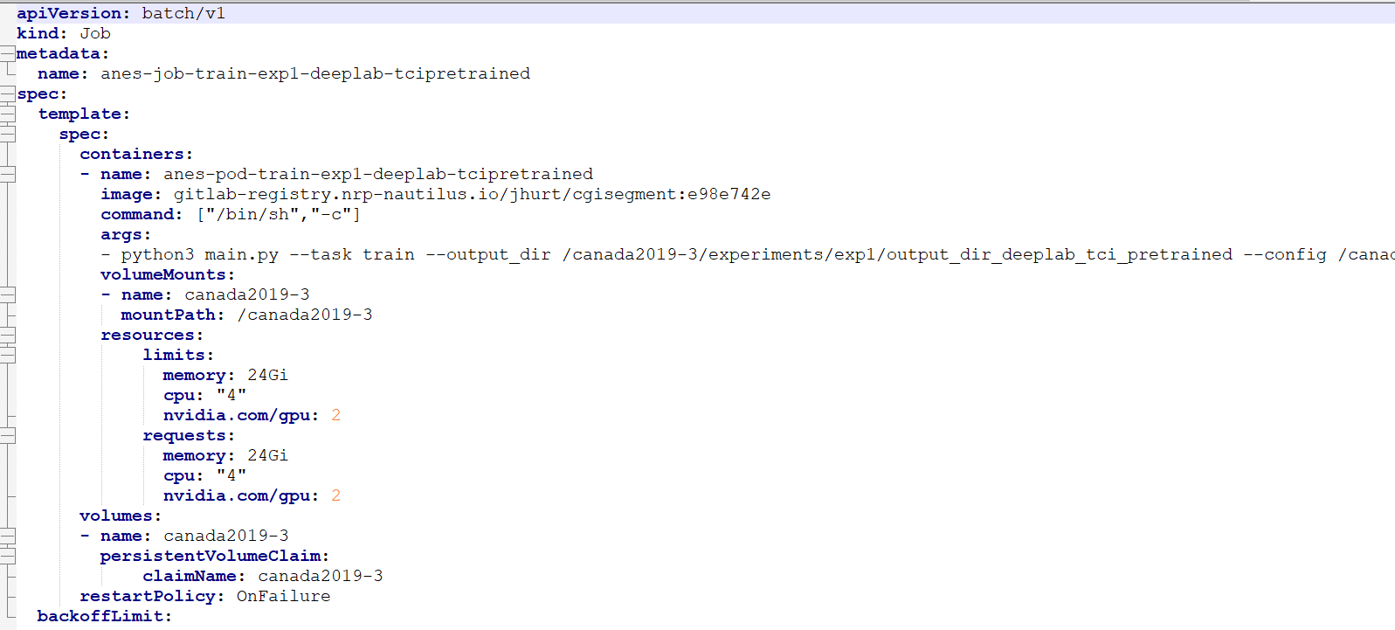
Preparing workspace yaml files

Slide 12
Preparing workspace Auto mass generating of config/yml files
Config files were autogenerated
Yml files were autogenerated
Jobs were auto submitted
Jobs were auto deleted after completion
Using Jupyter notebook
Jinja library
Using Windows/Linux bash files

Slide 13
Sample Automation Script
@ECHO OFF
Rem This batch file executes kubectl commands to create training jobs
::echo %kubectl%
SET exp_list=2 3 4 5 6 7 8 9 10 11 12 13 14 15 16 17 18
(for %%a in (%exp_list%) do (
echo %%a
kubectl create -f experiments\exp%%a/job_exp%%a_deeplab_img.yaml
kubectl create -f experiments\exp%%a/job_exp%%a_deeplab_tci.yaml
kubectl create -f experiments\exp%%a/job_exp%%a_deeplab_img_pretrained.yaml
kubectl create -f experiments\exp%%a/job_exp%%a_deeplab_tci_pretrained.yaml
))
echo "batch complete"%

Slide 14
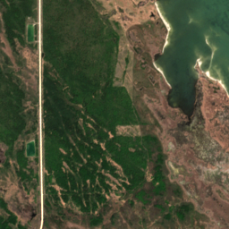
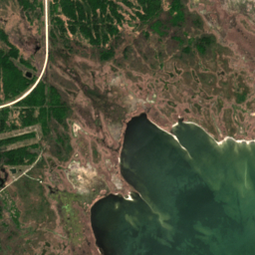
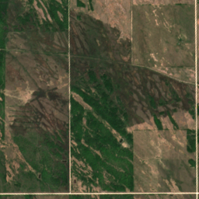
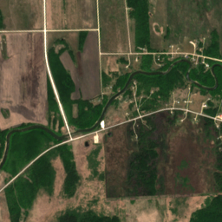
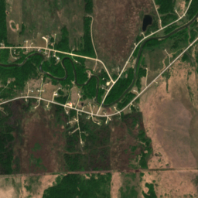
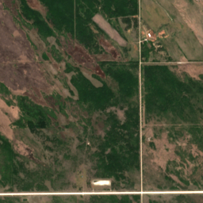
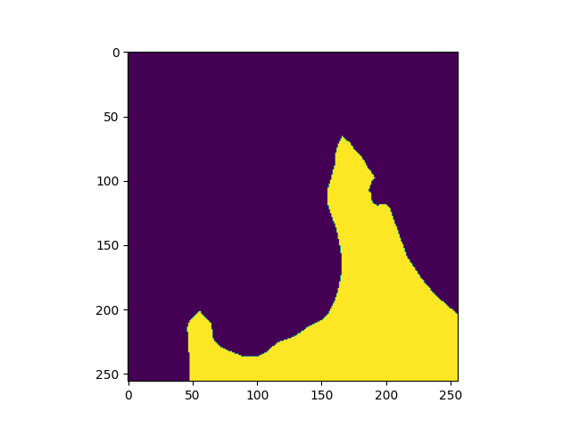
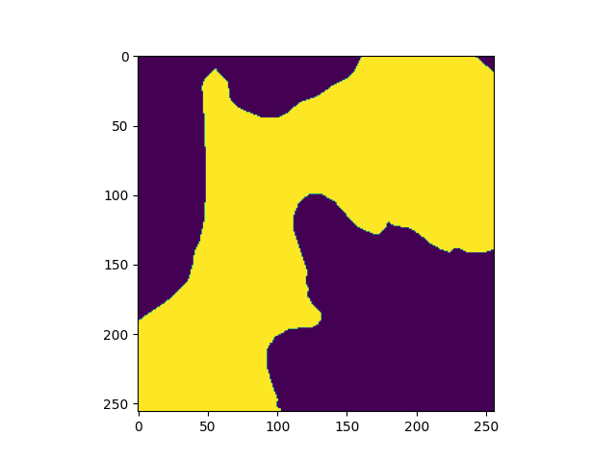
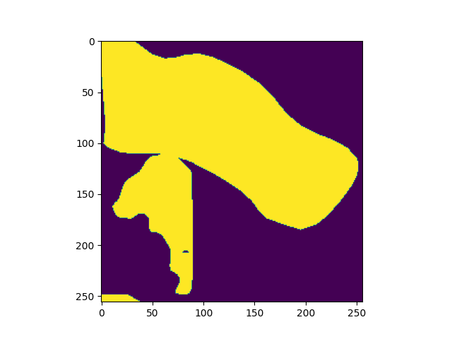
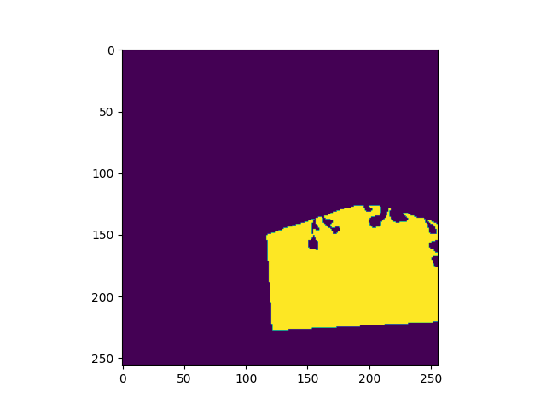
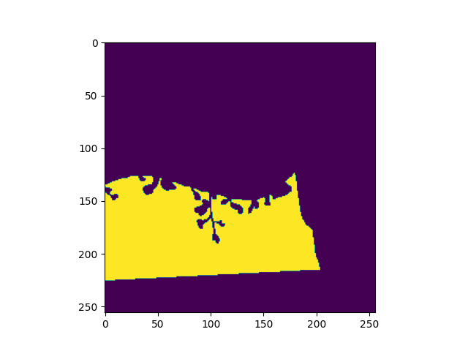
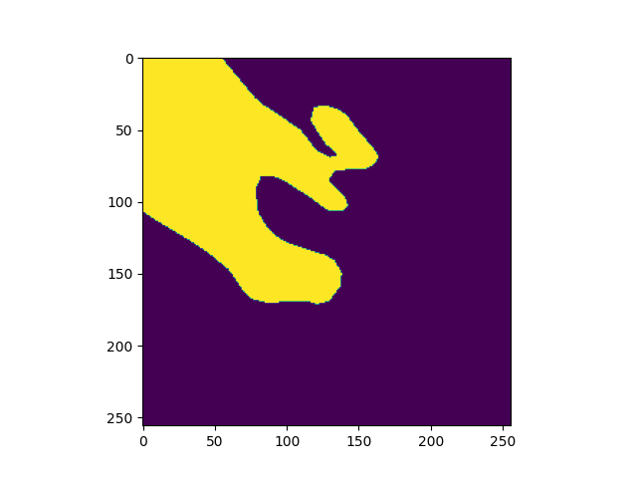






Results sample

Slide 15
Statistics about using Nautilus
Iterations of Training Completed: 515,550
Number of images Processed: 7,070,400
Trainable Parameters Optimized: 23 millions per model
The time it took to prepare the experimental set up and to run all the training sessions in parallel is 12 hours
The actual time it would have take to train is 21 days 12 hours 45 minutes

